Slide 1
Description of A/B testing
The subject of the test - the weekly premium subscription screen.
Groups:
A (control) is an old screen that offers a weekly subscription for $4.99.
B (test) – new screen that also offers a weekly subscription for $4.99, but presents it as a 50% discount.
The goal is to raise the CR to subscription.
Duration - 22 days (07/03/2023 - 07/25/2023).
The level of confidence interval (the maximum probability of rejecting H0 if it is correct) is 0.05.
User sampling – stratified by operating system type, gender, age group, location, traffic source to minimize the impact of extraneous factors.
Hypotheses:
H0 - the new design has no effect on the conversion into a subscription.
H1 - the new design affects the conversion to subscription.

Slide 2
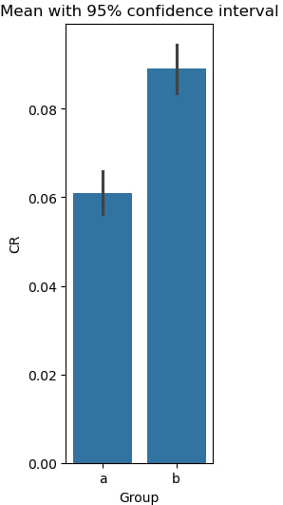
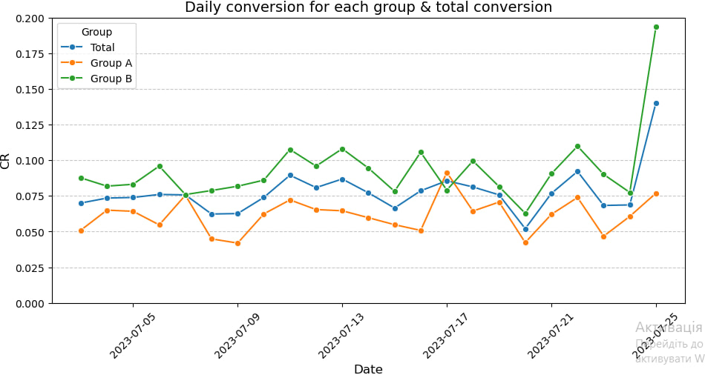
Results of A/B testing
Group | CR to subscription, % | Size
A | 6,1 | 10013
B | 8,9 | 9985
The key metric - CR to subscription – the test group is 45.9% better than the control group.
The z-test found that the P-value is ≈ 0.0000045, so the probability that the experimental option is better at encouraging users is ≈ 99.99%.
P-value < confidence interval, so result is statistically significant.
From the graph of the daily conversion, it can be seen that in 21 of 23 days the CR in the test group is better.

Slide 3
Conclusion
Because the new window increases the conversion to subscription, it was made an decision to completely switch to a new design. So, the A/B test is successful.

